Slide 1
Transmission Media

Slide 2

Figure 7.1 Transmission medium and physical layer
7.<number>

Slide 3

Figure 7.2 Classes of transmission media
7.<number>

Slide 4
7-1 GUIDED MEDIA
Guided media, which are those that provide a conduit from one device to another, include twisted-pair cable, coaxial cable, and fiber-optic cable.
Topics discussed in this section:
Twisted-Pair Cable
Coaxial Cable
Fiber-Optic Cable
7.<number>

Slide 5

Figure 7.3 Twisted-pair cable
7.<number>

Slide 6

Figure 7.4 UTP and STP cables
7.<number>

Slide 7
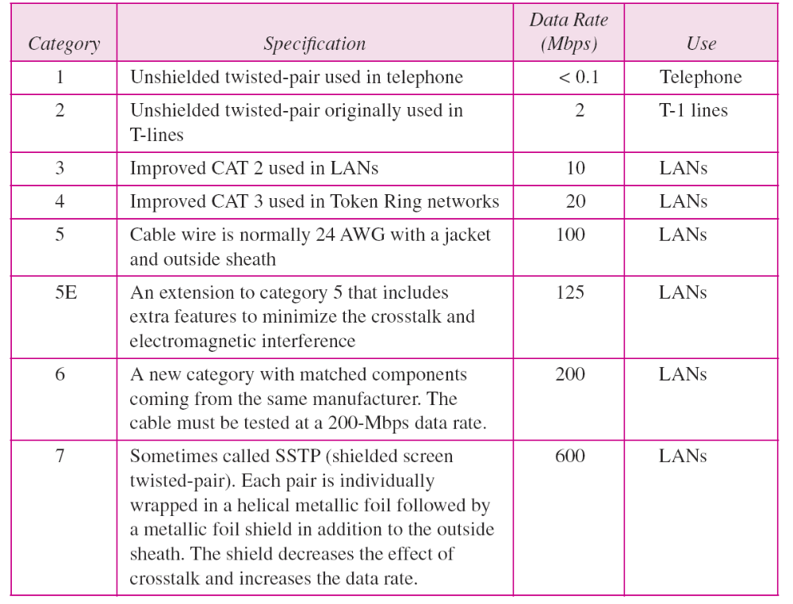
Table 7.1 Categories of unshielded twisted-pair cables
7.<number>

Slide 8

Figure 7.5 UTP connector
7.<number>

Slide 9

Figure 7.6 UTP performance
7.<number>

Slide 10

Figure 7.7 Coaxial cable
7.<number>

Slide 11

Table 7.2 Categories of coaxial cables
7.<number>

Slide 12

Figure 7.8 BNC connectors
7.<number>

Slide 13

Figure 7.9 Coaxial cable performance
7.<number>

Slide 14

Figure 7.10 Fiber optics: Bending of light ray
7.<number>

Slide 15

Figure 7.11 Optical fiber
7.<number>

Slide 16

Figure 7.12 Propagation modes
7.<number>

Slide 17

Figure 7.13 Modes
7.<number>

Slide 18
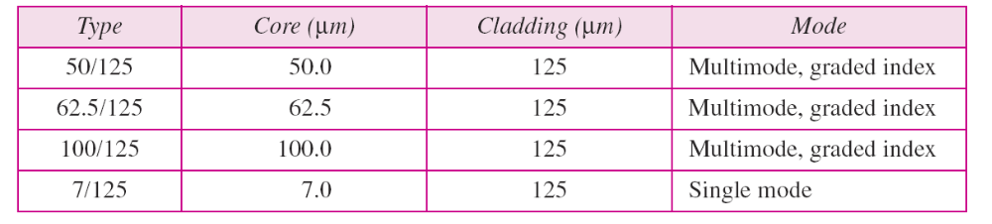
Table 7.3 Fiber types
7.<number>

Slide 19

Figure 7.14 Fiber construction
7.<number>

Slide 20

Figure 7.15 Fiber-optic cable connectors
7.<number>

Slide 21

Figure 7.16 Optical fiber performance
7.<number>

Slide 22
7-2 UNGUIDED MEDIA: WIRELESS
Unguided media transport electromagnetic waves without using a physical conductor. This type of communication is often referred to as wireless communication.
Topics discussed in this section:
Radio Waves
Microwaves
Infrared
7.<number>

Slide 23

Figure 7.17 Electromagnetic spectrum for wireless communication
7.<number>

Slide 24

Figure 7.18 Propagation methods
7.<number>

Slide 25
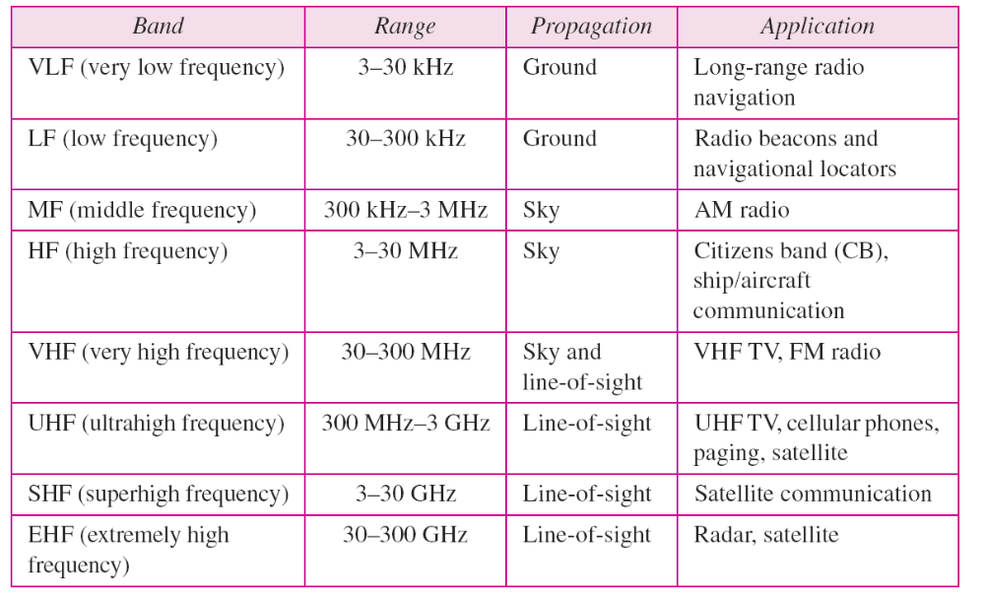
Table 7.4 Bands
7.<number>

Slide 26

Figure 7.19 Wireless transmission waves
7.<number>

Slide 27

Note
Radio waves are used for multicast communications, such as radio and television, and paging systems. They can penetrate through walls.
Highly regulated. Use omni directional antennas
7.<number>

Slide 28

Figure 7.20 Omnidirectional antenna
7.<number>

Slide 29
Note
Microwaves are used for unicast communication such as cellular telephones, satellite networks,
and wireless LANs.
Higher frequency ranges cannot penetrate walls.
Use directional antennas - point to point line of sight communications.
7.<number>

Slide 30

Figure 7.21 Unidirectional antennas
7.<number>

Slide 31
Note
Infrared signals can be used for short-range communication in a closed area using line-of-sight propagation.
7.<number>

Slide 32
Wireless Channels
Are subject to a lot more errors than guided media channels.
Interference is one cause for errors, can be circumvented with high SNR.
The higher the SNR the less capacity is available for transmission due to the broadcast nature of the channel.
Channel also subject to fading and no coverage holes.
7.<number>

